Slide 1

WIRELESS COMMUNICATIONS • ASSIGNMENT 4
Rician Fading &
Jakes Spectrum

Slide 2

1. Rician Flat-Fading Model
What is it?
Envelope Calculation
Rician fading occurs when there is a dominant Line-of-Sight (LOS) component alongside multipath scattering. It is common in satellite links or open environments.
Signal = (g1 + g2•X) + j(g1 + g2•Y)
Where X, Y are Gaussian Random Variables
The K-Factor
The received envelope r is the magnitude of this complex signal.
The ratio of LOS power to scattered power.
•
K = 0: No LOS. Reduces to Rayleigh Fading.
•
K = ∞: Pure LOS. No Fading (Gaussian channel).

Slide 3
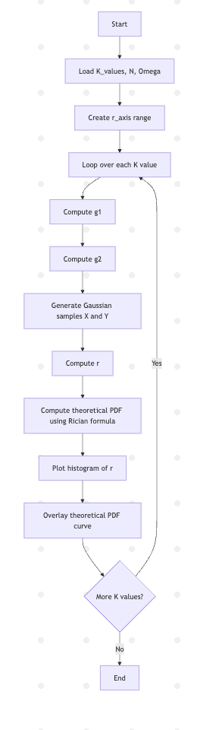







Data Flow: Rician Simulation
[0, 3, 7, 12, 15]
Gaussian X, Y
r = |Signal|
Compare with Theory

Slide 4
Pseudo Code: Rician Fading
START
SET K_values = [0, 3, 7, 12, 15]
SET N = 100000
SET Omega = 1
SET r_axis = linspace(0, 3)
FOR each K in K_values:
COMPUTE g1 = sqrt( K / (2 * (K + 1)) ) // LOS component
COMPUTE g2 = sqrt( 1 / (2 * (K + 1)) ) // Scattered component
GENERATE X = random Gaussian samples of size N
GENERATE Y = random Gaussian samples of size N
// Generate Rician envelope (practical)
COMPUTE r = sqrt( (g1 + g2*X)^2 + (g1 + g2*Y)^2 )
// Compute theoretical PDF
FOR each value in r_axis:
COMPUTE pdf = (2*(K+1)/Omega) * r_axis *
exp( -(K+1)/Omega * r_axis^2 - K ) *
BesselI0( 2 * r_axis * sqrt(K*(K+1)) / Omega )
END FOR
PLOT histogram of r
OVERLAY theoretical PDF curve
END FOR
END
Humanized Explanation
Why calculate g1 & g2?
The total energy must remain 1. As 'K' increases, we allocate more energy to the direct path (g1) and less to the scattered path (g2).
The 'Loop' Logic:
We repeat the experiment for different K values to visualize how the probability density function (PDF) shifts shape.

Slide 5
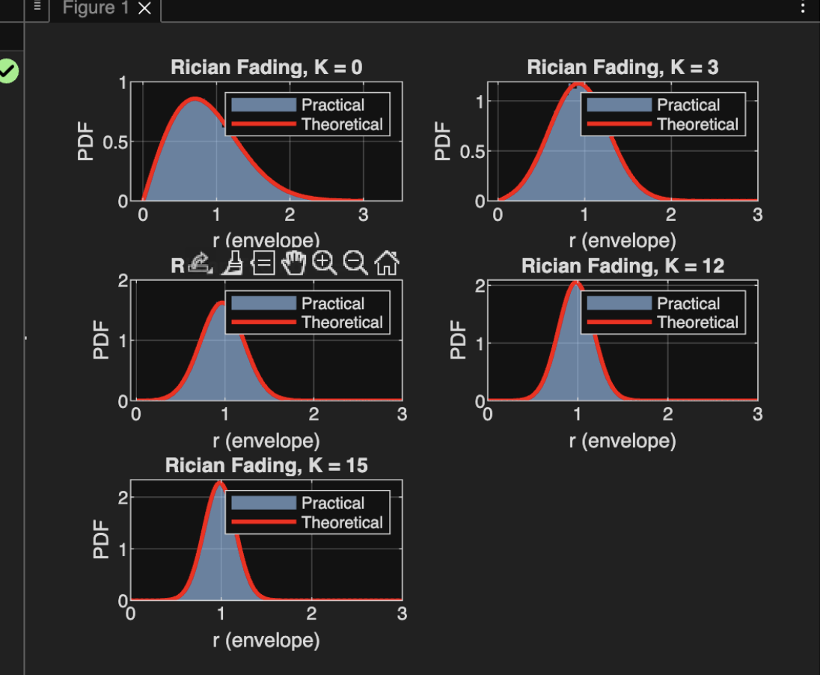
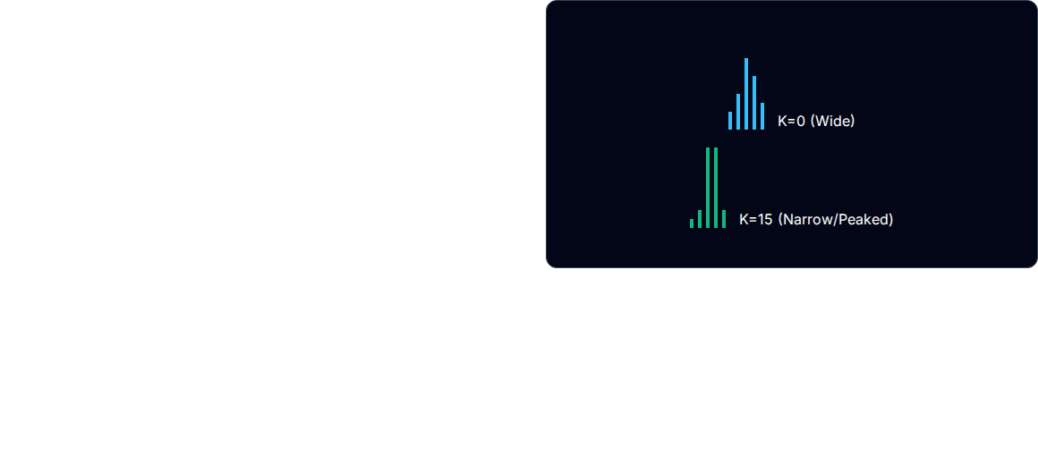
Rician Simulation Results
Key Observations
•
K = 0 (Rayleigh): The graph is skewed left. It has no dominant component.
•
K = 7 to 15: As K increases, the graph becomes a symmetrical "bell curve" (Gaussian).
•
Shift: The peak moves to the right (around 1.0) as the signal becomes stable and less random.

Slide 6

2. Jakes Spectrum & Autocorrelation
The Concept
When a receiver moves through a multipath environment, the received frequency shifts due to the Doppler Effect.
Power Spectral Density S(f):
Jakes model describes the power spectral density (PSD) of this fading channel.
The "U" Shape
The PSD is maximum at ± f max (moving directly towards/away from the source) and minimum at 0 Hz (moving perpendicular).

Slide 7
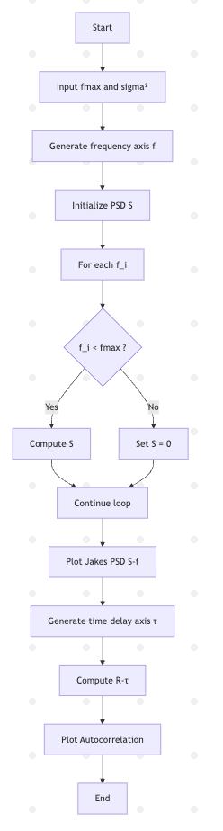

Slide 8
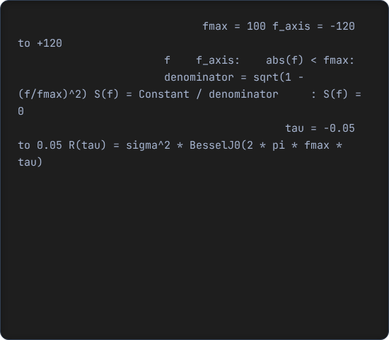
Pseudo Code: Jakes Spectrum
START
SET fmax = 100
SET sigma2 = 1
// Frequency axis
SET f = linspace( -1.2*fmax , 1.2*fmax )
INITIALIZE PSD array S of same size as f
FOR each frequency value f_i in f:
IF |f_i| < fmax THEN
COMPUTE S[i] = sigma2 / ( pi * fmax * sqrt( 1 - (f_i/fmax)^2 ) )
ELSE
SET S[i] = 0
END IF
END FOR
PLOT S vs f // Jakes Doppler spectrum
// Autocorrelation function
SET tau = linspace( -0.05 , 0.05 )
FOR each tau_i in tau:
COMPUTE R[i] = sigma2 * BesselJ0( 2 * pi * fmax * tau_i )
END FOR
PLOT R vs tau // Jakes autocorrelation function
END
Logic Explanation
// 1. Define Frequency Range
// 2. Calculate PSD (The U-Shape)
The Mask: In the code, we use a condition abs(f) < fmax. This is because the signal only exists within the Doppler shift limits. Outside this range, the power is zero.
// Go slightly beyond fmax
FOR EACH
IN
IF
// Apply Jakes Formula
ELSE
// Theoretical formula using Bessel Function
END IF
END LOOP
// 3. Calculate Autocorrelation
Autocorrelation: The code uses besselj(0, ...). This mathematical function perfectly describes how the correlation of the signal ripples and fades over time delay (tau).

Slide 9
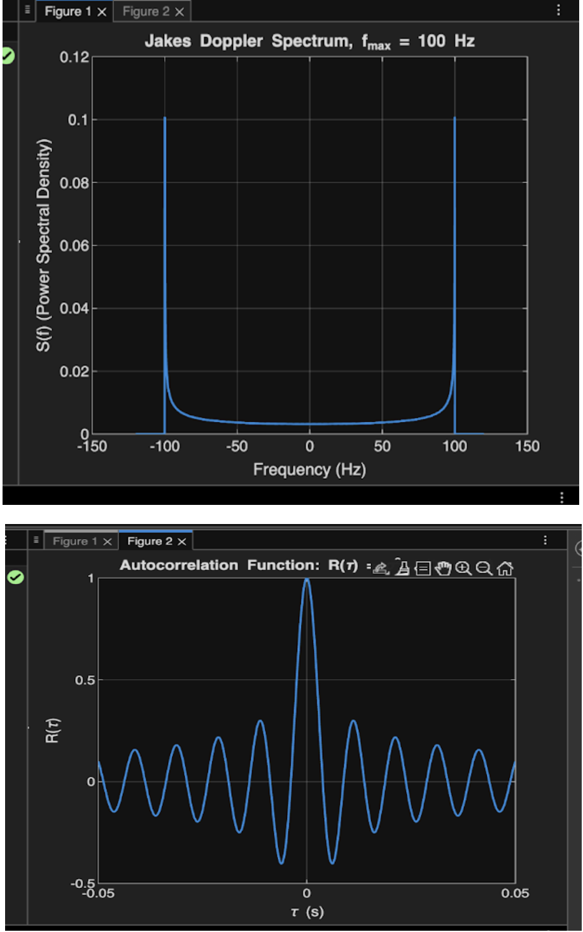
Jakes Model Results
1. Power Spectral Density
Sharp peaks at edges (-100, 100 Hz).
This is the classic "Bathtub" or "U" shape.
2. Autocorrelation R(τ)
A Bessel function (Sinc-like).
Shows how quickly the channel changes.

Slide 10


Summary
Rician Fading
Jakes Spectrum
Models environments with a clear Line-of-Sight. The K-factor determines if the channel behaves like Rayleigh (Chaotic) or Gaussian (Stable).
Models the frequency shift caused by motion. The U-shaped PSD proves that most energy arrives at the maximum Doppler shift.

